Slide 1
Data visualization Lessons from cognitive science to improve comprehension Alana Deranek, MBA February 2020

Slide 2

Alana Deranek, MBA Bachelor of Arts, Communication Studies (University of Minnesota) Master of Business Administration (Augsburg) Optum Data Science University – Optum Scale Data Science (UnitedHealth Group)
Academic study Communication studies, human cognition, psychology, behavior change, data analysis, statistics
Professional background Reporting and analytics, Tableau development, data analysis, SQL coding, program evaluation, performance management, market analysis
Personal interests Art, music, outdoor activities, travel, photography

Slide 3
Patterns and perception

Slide 4
Gestalt psychology
“Gestalt” is German for “unified whole”
Early 20th century German psychologists Wertheimer, Koffka & Kohler
How do our brains use perception and our past experiences to make sense of sometimes chaotic reality?
Designers use “Gestalt Principles” in advertising, web design, data viz, etc.

Slide 5

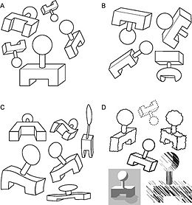
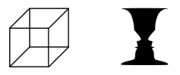
Gestalt systems: visual perception
Reification
Multistability
Invariance
Humans perceive more spatial information than is necessarily provided in all instances (“optical illusions”) (we prefer complete, rational objects to incomplete, nonsensical visual cues)
Experience of some images “jumping around” or being unstable
Ability to recognize an object despite changes in rotation, scale, deformity, shadow, etc.

Slide 6
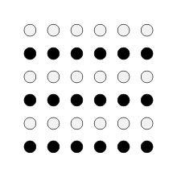

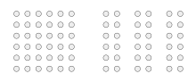
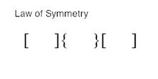

Gestalt psychology: patterns in systems
Similarity
Continuation
Closure
Proximity
Symmetry
If objects are similar, put them together
If part of the object is there, then all the object should be there
We perceive completeness, even when it isn’t there (remember reification)
If objects are near each other, they must be related (even if they aren’t)
Objects are symmetrical, forming around a center (we imagine this even when it isn’t true)
https://en.wikipedia.org/wiki/Gestalt_psychology#Quantum_cognition_modeling
Notes:
* Continuation: be aware of audience assumptions about continuation, even when it does not exist

Slide 7
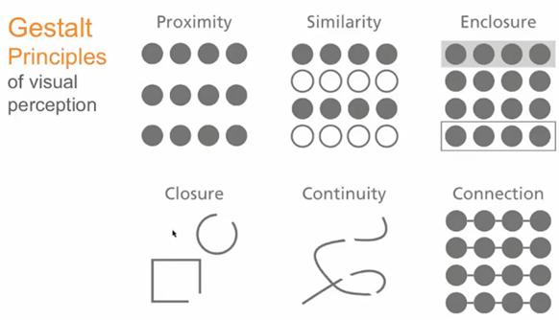
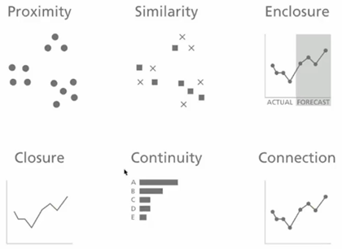
More Gestalt…
*DSU OSDS lecture materials

Slide 8
Anscombe’s quartet Data sets look similar…

Slide 9
Anscombe’s quartet Data sets look similar…until we graph them
Data sets can have very different distributions yet nearly identical descriptive statistics. Graph your data, look for outliers and other observations.

Slide 10

Color

Slide 11
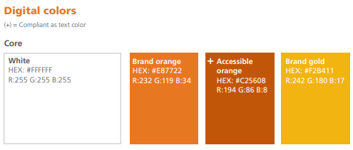
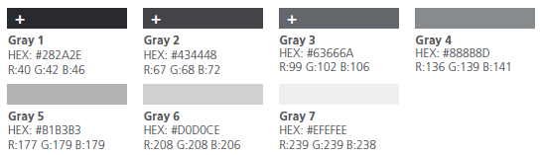
Color should mean something
Use color sparingly and predictably
Only use “compliant” colors for text (need to be dark enough to read)
Use color for impact, not for fun
White space is good
Branding
Save a custom color palette in Tableau (preferences.tps file) to maintain consistency
https://help.tableau.com/current/pro/desktop/en-us/formatting_create_custom_colors.htm
Example of a company’s branding guidelines for color:

Slide 12

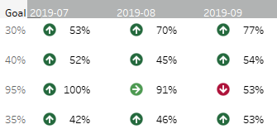
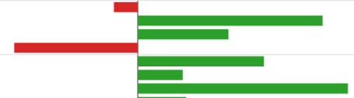
Color vision deficiency (CVD) “Color blind”
Red-green color deficiency affects approximately 8% of males
Protanopia (red-blindness)
Protanomaly (red-weakness)
Deuteranopia (green-blindness)
Deuteranomaly (green-weakness)
Best: avoid stop light colors to symbolize performance
Compromise: add arrows, symbols, context so they make sense without the “stoplight” colors

Slide 13


Slide 14
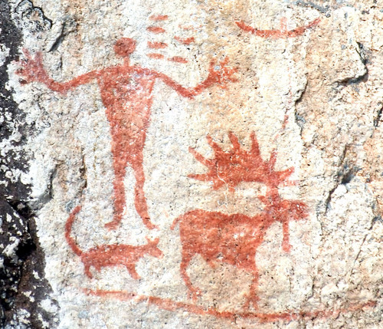

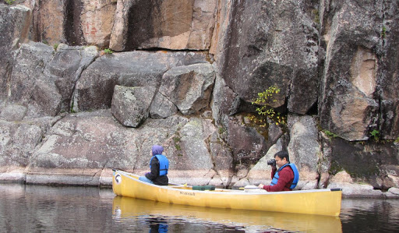
Boundary Waters Canoe Wilderness Area Hegman Lake pictographs
https://www.google.com/imgres?imgurl=https%3A%2F%2Fastrobob.areavoices.com%2Fastrobob%2Fimages%2FHegman_full_picto_VERY_TIGHT.jpg&imgrefurl=https%3A%2F%2Fastrobob.areavoices.com%2F2009%2F09%2F25%2Fthe-mystery-of-the-hegman-lake-pictographs%2F&tbnid=gz48nzWoZM3vxM&vet=12ahUKEwiQyOrog7vnAhUO96wKHeueBjUQMygDegUIARDUAQ..i&docid=UU3gnMozO7JBUM&w=500&h=429&q=boundary%20waters%20hegman%20lake&ved=2ahUKEwiQyOrog7vnAhUO96wKHeueBjUQMygDegUIARDUAQ
https://www.google.com/url?sa=i&url=https%3A%2F%2Fwww.youtube.com%2Fwatch%3Fv%3DHPVNWDajj6o&psig=AOvVaw0KROCe0cq2b4kxt8SZx_m9&ust=1581013347205000&source=images&cd=vfe&ved=0CAIQjRxqFwoTCLCXmauEu-cCFQAAAAAdAAAAABAW
https://www.google.com/imgres?imgurl=http%3A%2F%2Fwww.adirondackmountainsrealestate.com%2FHegman_Lake_092411_pictographs_Em-Bharath.JPG&imgrefurl=http%3A%2F%2Fwww.adirondackmountainsrealestate.com%2FBoundary_Waters_Hegman_Lake.html&tbnid=buqUbQi5-A8LMM&vet=12ahUKEwiQyOrog7vnAhUO96wKHeueBjUQMygZegQIARA4..i&docid=2uyUxr9mQaqx5M&w=1280&h=747&q=boundary%20waters%20hegman%20lake&ved=2ahUKEwiQyOrog7vnAhUO96wKHeueBjUQMygZegQIARA4

Slide 15
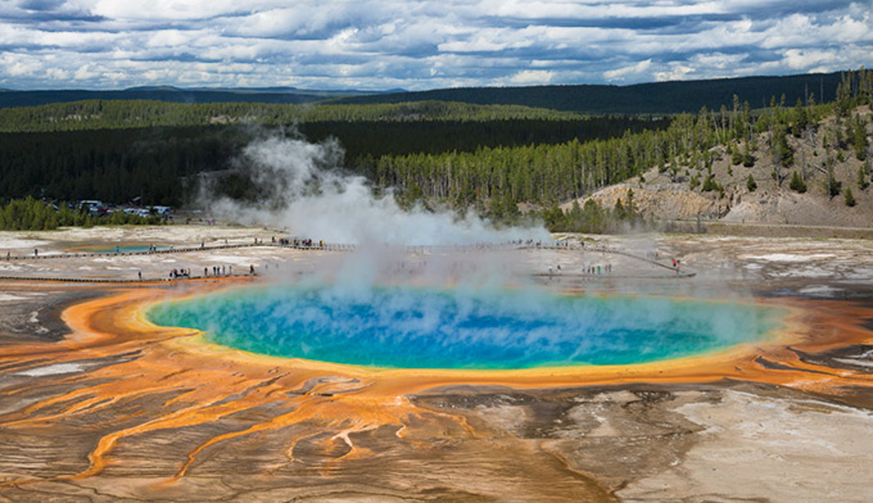
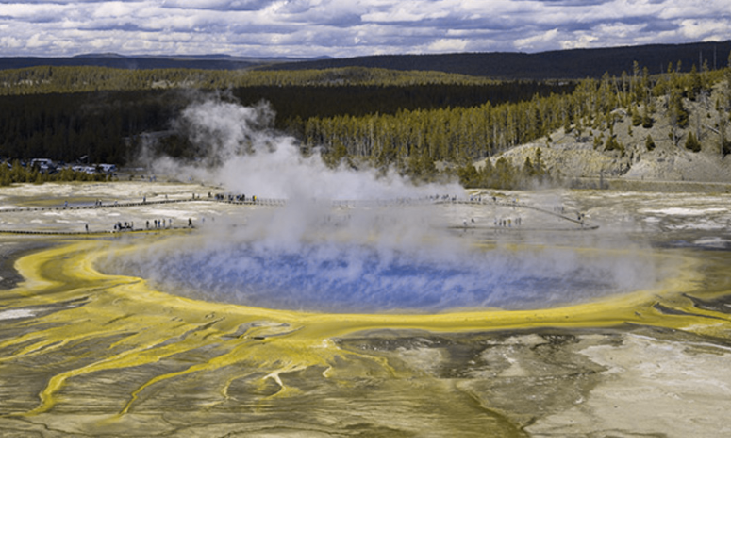
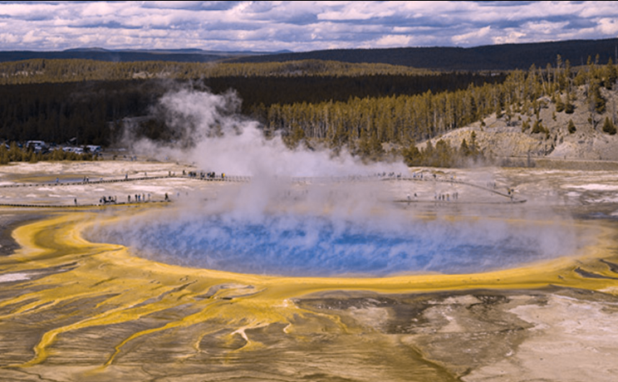
Yellowstone National Park Midway Geyser Basin
Red-blind (protanopia)
Green-blind (deuteranopia)
Yellowstonepark.com

Slide 16
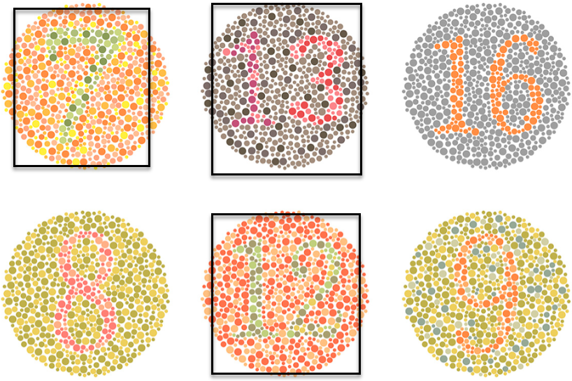
What does color deficiency look like?

Slide 17
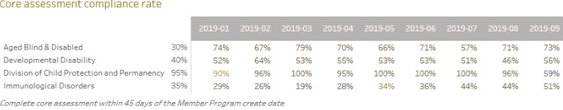
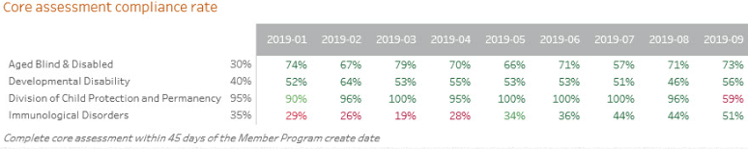
Color blindness simulator Can you tell which program is underperforming?
https://www.color-blindness.com/coblis-color-blindness-simulator/
In the view below, the stop light color indicates the % of each program’s goal on the left of the chart (30%, 40%, 95%, 35%). Without color, the meaning is lost.
With red-blind vision (protanopia)
With full color vision

Slide 18
Dashboard layout & fonts

Slide 19
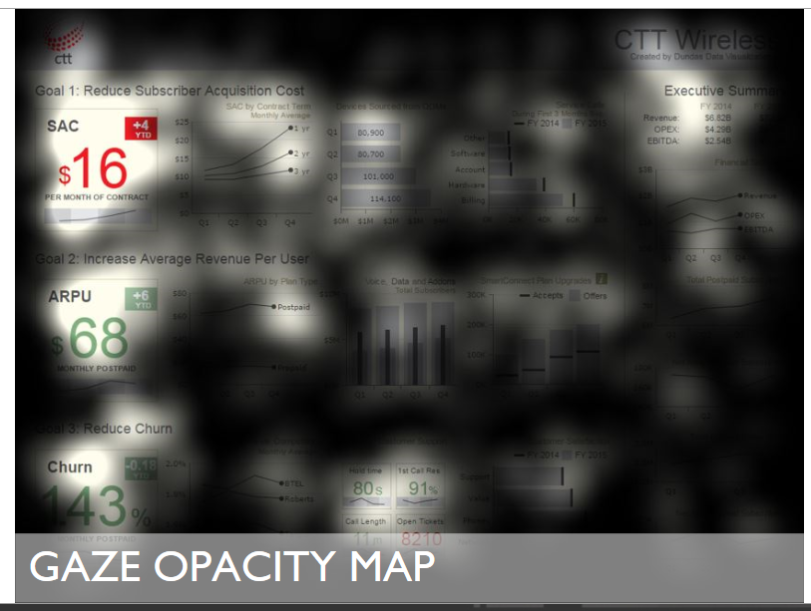
Dashboard layout Tableau eye tracking studies
What they measured
Where on the screen and for how long a person’s gaze rested
What they learned
What features / objects attract? faces, maps, pictures, icons
Larger font for callouts (instead of just changing weight or color)
Focus towards top right for callouts
Avoid repeating the same type of graph, monotony loses attention
https://event.on24.com/eventRegistration/console/EventConsoleApollo.jsp?&eventid=1518149&sessionid=1&username=&partnerref=&format=fhaudio&mobile=false&flashsupportedmobiledevice=false&helpcenter=false&key=23F7CBEC2ACEC042381210CE392CE24A&text_language_id=en&playerwidth=1000&playerheight=650&overwritelobby=y&eventuserid=181792143&contenttype=A&mediametricsessionid=150521590&mediametricid=2177346&usercd=181792143&mode=launch

Slide 20
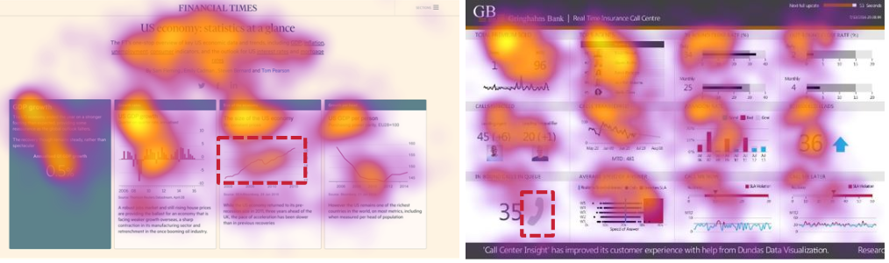
Dashboard layout Tableau eye tracking studies
Surprise finding
Callouts, jagged lines / dashed lines were not effective in grabbing attention
https://event.on24.com/eventRegistration/console/EventConsoleApollo.jsp?&eventid=1518149&sessionid=1&username=&partnerref=&format=fhaudio&mobile=false&flashsupportedmobiledevice=false&helpcenter=false&key=23F7CBEC2ACEC042381210CE392CE24A&text_language_id=en&playerwidth=1000&playerheight=650&overwritelobby=y&eventuserid=181792143&contenttype=A&mediametricsessionid=150521590&mediametricid=2177346&usercd=181792143&mode=launch

Slide 21
Fonts
Follow brand guidelines
Stick with one or two fonts for consistency
Be predictable in sizing
Limit font sizes to 3 or 4 (title, body, footnote, etc.). Try to jump at least 2 steps in-between sizes (go from font size 8 up to font size 12 for example) if practical
San serif (Arial) vs. Serif (Times New Roman) fonts
Default font in Tableau is too small / light for some viewers to read (have your end users test – ask for feedback on font size / weight specifically)
A colored background (even very light grey) can make the font harder to read (not always – need to test your visualization)
Don’t forget about white font against dark background for headers / titles

Slide 22
Chart selection

Slide 23
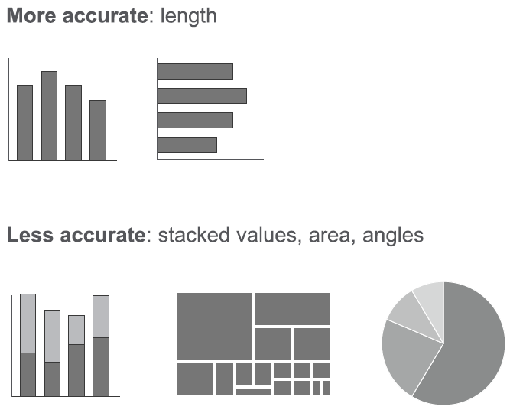
Estimating area How accurate is the human brain at estimating visual area?
Visual aid from “Data Visualization Design Essentials” presentation by Kristan Hodge

Slide 24
Chart selection: what do you want to show?
Comparison
How many categories, variables?
Over time…few periods or many periods? Is your data cyclical?
Distribution
Single or two variables?
Few data points or many data points?
Composition
Changing over time or static?
Do absolute or relative differences matter?
Relationship
How many variables (two or three)

Slide 25
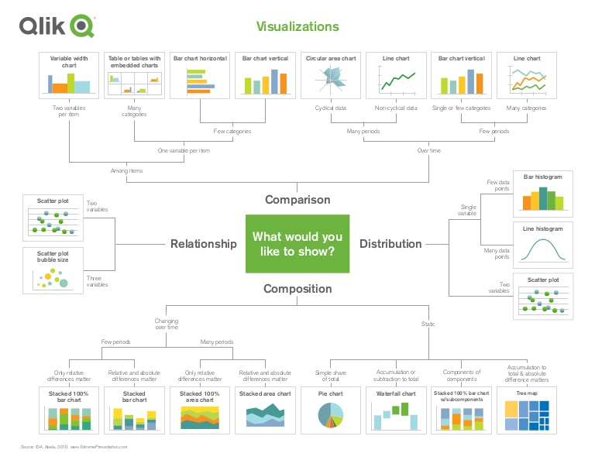
Selecting a visualization
https://blog.qlik.com/assets/uploads/images/posts/patrik-lundblad/goodchart-xlarge-1200x630.jpg

Slide 26
Should all graphs start at zero? The great debate!
Month | Performance
January | 96%
February | 98%
March | 99%
April | 94%
May | 99%
June | 97%
July | 98%
August | 96%
September | 95%
October | 94%
November | 99%
December | 98%

Slide 27
What else?
Resources
Tableau.com
Edward Tufte (Visual Display of Quantitative Information)
Steve Wexler (The Big Book of Dashboards)
http://www.color-blindness.com/coblis-color-blindness-simulator/
Others?

Slide 28
Alana Deranek, MBA Healthcare Analyst Principal Blue Cross Blue Shield MN Alana.Deranek@bluecrossmn.com
Thank you!

